Slide 1
Spreadsheets: Job Skills AND Algebra
MaTHink 2014
Susan Addington
Cal State San Bernardino

Slide 2
Materials
Materials (PowerPoint, example spreadsheet, book chapter) are at
http://www.quadrivium.info
(under Presentations)

Slide 3
Common Core Standards for Mathematical Practice
5. Use appropriate tools strategically.
7. Look for and make use of structure.
8. Look for and express regularity in repeated reasoning.

Slide 4
What is a mathematical structure?
A template that fits a number of related mathematical situations.
Examples:
  An expression
  An equation
  A function
  A linear function
  A proof
  A property of the real numbers

Slide 5
More structures
A column table
A “grid” table
Pounds of cheese | cost
1 | $4.79
2 | $9.58
1.6 | $7.66
 |  | Second letter
 |  | A | B
First letter | A | AA | AB
 | B | BA | BB

Slide 6
More structures
A graph
Pounds of cheese | Cost
0 | $0.00
1 | $4.79
2 | $9.58
1.6 | $7.66
3.8 | $18.20
7.2 | $34.49

Slide 7
More structures
A graph in 3 dimensions. These both show
z = x + y

Slide 8
Guess My Rule
Play several games of Guess My Rule using a spreadsheet
[spreadsheet demo]
How can students resolve questions about whether a rule gives the same outputs?

Slide 9
Spreadsheets for Guess My Rule
Note that a rule can be typed by clicking in cells or by typing addresses of cells:
Could also do it in two steps:
Fill down instead of retyping.
 | A | B | C
3 | 5 | 9 | =3*A3-6
 | A | B | C | D | E
3 | 5 | 9 | =3*A3-6 | =3*A3 | =D3-6

Slide 10
Where’s the math?
What mathematical structures can you find in this activity?
What other mathematical ideas or techniques do you see?

Slide 11
Some possible answers
Functions
Expressions
Equivalent expressions, simplification, properties of the number system

Slide 12
Graphs
Did you think to make a graph to find a rule?
How to do it:
  Highlight the region of cells to put in the graph
  Choose Charts (or Insert chart), Scatter/xy
  Click in the spreadsheet to place the chart.

Slide 13
Several input/output pairs from Rule 1 in a graph

Slide 14
Software for better graphs: GeoGebra
Free from http://geogebra.org or App stores
Runs on Mac, Windows, Linux, ipad, Android tablets
Computer version includes geometry, spreadsheet, computer algebra system
Tablet version does not have spreadsheet or computer algebra (yet).
There is a beta version of a 3D version (computers only so far.)

Slide 15
Guess and Check Tables
A modern version of a (historically) pre-algebra technique for solving equations
Guess what the answer is
Check to see if you’re right.
If not, use the results to get a better guess

Slide 16
Guess and Check Tables
An algebra word problem:
  Fifty-one more than 9 times a number is 114.
  What is the number?
The number | 9 times the number | 51 more than 9 times the number | Is result = 114?
10 | 9•10 = 90 | 9•10 + 51 = 141 | 9•10 + 51 =? 114 NO
5 | 9•5 = 45 | 9•5 + 51 = 96 | 9•5 + 51 =? 114 NO
6 | 9•6 = 54 | 9•6 + 51 = 105 | 9•6 + 51 =? 114 NO
7 | 9•7 = 63 | 9•7 + 51 = 114 | 9•6 + 51 =? 114 YES

Slide 17
Guess and Check Tables
Guess and check tables in algebra teaching: setting up the table
Make a column table
  First column: the guesses for the answer
  Other columns: steps in calculating the check
  Final column: a way to see if answer is correct
Write expressions, in addition to numbers
Write expressions in each row the same way

Slide 18
Guess and Check Tables
Transition to algebra
After several guesses, replace the guess with a variable
  First column: the variable
  Other columns: expressions involving only the variable and numbers (often need to be simplified)
  Final column: an equation
Solve the equation algebraically

Slide 19
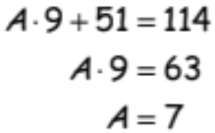
Guess and Check Tables
Write an equation based on the table.
The number | 9 times the number | 51 more than 9 times the number | Is result = 114?
10 | 9•10 = 90 | 9•10 + 51 = 141 | 9•10 + 51 =? 114 NO
5 | 9•5 = 45 | 9•5 + 51 = 96 | 9•5 + 51 =? 114 NO
6 | 9•6 = 54 | 9•6 + 51 = 105 | 9•6 + 51 =? 114 NO
7 | 9•7 = 63 | 9•7 + 51 = 114 | 9•6 + 51 =? 114 YES
A | 9•A | 9•A + 51 | 9•A + 51 = 114

Slide 20
Try a guess and check table.
(From Measuring the World)
  Jeremiah bought a toy on sale for 20% off.
  He paid $11.02 (there was no sales tax.)
  What was the regular price of the toy?

Slide 21
Try a guess and check table.
(From EdHelper.com)
  Isaac is nine years older than Kylie.
  Isaac is four times as old as Brian was three years ago.
  Brian is eighteen years younger than Isaac.
  How old is Kylie?

Slide 22
Try a guess and check table.
(The Abbot of Canterbury’s Puzzle: AD 735–804. From Tony Gardiner.)
  One hundred bushels of corn were distributed among one hundred people in such a way that each man received three bushels, each woman received two bushels, and each child received half a bushel.
  Given that there were five times as many women as men, how many children were there?

Slide 23
Variables, unknowns, symbols with rules
What’s the difference between a variable and an unknown?
  Unknown in a problem: X is a specific number, but you don’t know what it is.
  (And what if there are several solutions for X, as in a quadratic equation?)
  Variable: any/all possible values for X,
  as in Y=f(X)
Are ideas these different from a variable as a letter that you do algebra to?

Slide 24
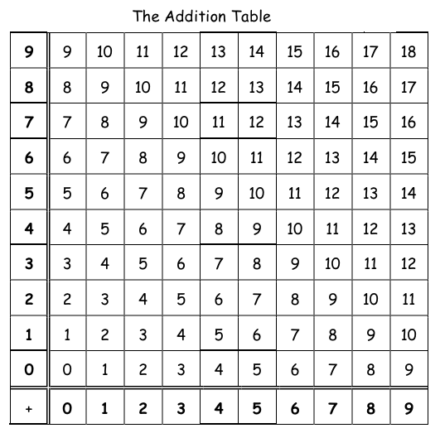
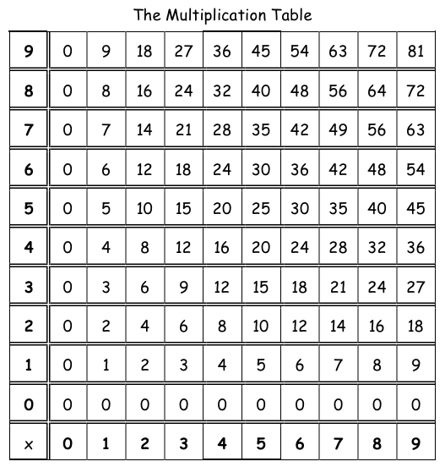
Grid tables
Prototypes: the addition and multiplication tables

Slide 25
Grid tables
Headings in 2 directions to show 2 quantities
Usually top and left
I’ll do bottom and left, to coordinate with graphs
Spreadsheet technique: Absolute cell references
  Put a $ sign in front of the part of a cell address that should NOT change when copied.

Slide 26
Spreadsheet technique: Absolute cell references
  Why does column B have only one correct entry?.
 | A | B | C | D | E
1 | lb. of cheese | Cost | Cost per lb.: |  | Cost
3 | 1 | $4.00 | $4.00 |  | $4.00
4 | 2 | $0.00 |  |  | $8.00
5 | 3.5 | $0.00 |  |  | $14.00

Slide 27
Spreadsheet technique: Absolute cell references
  Put a $ sign in front of the part of a cell address that should NOT change when copied or filled.
  $C$2 will change neither row nor column when copied.
 | A | B | C | D | E
1 | lb. of cheese | Cost | Cost per lb.: |  | Cost
3 | 1 | =A2*C2 | $4.00 |  | =A2*C$2
4 | 2 | =A3*C3 |  |  | =A3*C$2
5 | 3.5 | =A4*C4 |  |  | =A4*C$2

Slide 28
Make an addition table
Fill to create the heading rows
Don’t change column A or row 1 when filling entries.
Fill across, then down to complete the table.
 | A | B | C | D
1 |  | 0 | 1 | 2
2 | 0 | =$A2*B$1
3 | 1
4 | 2

Slide 29
Apples and oranges problem
From Measuring the World
Adapted for Algebra I by the Hybrids Lesson Study group, project DELTA

Slide 30
Cost of combinations of apples and oranges.
Apples cost 9 cents. Oranges cost 18 cents.
Complete this table for the cost of apples and oranges.
Find patterns to save work.
Number of apples (y) | 11
 | 10
 | 9
 | 8
 | 7 | 126 |  |  |  |  |  |  | 189
 | 6 | 108 |  |  |  |  | 153 |  | 171
 | 5 | 90 |  |  |  |  |  |  | 153
 | 4 | 72 | 81 | 90 |  |  |  |  | 135
 | 3 | 54 | 63 | 72 |  |  |  |  | 117
 | 2 | 36 | 45 | 54 |  |  |  |  | 99
 | 1 | 18 | 27 | 36 |  |  |  |  | 81 |  |  | 108 | 117
 | 0 | 0 | 9 | 18 |  |  |  |  | 63 |  |  | 90 | 99
 |  | 0 | 1 | 2 | 3 | 4 | 5 | 6 | 7 | 8 | 9 | 10 | 11
 |  | Number of oranges (x)

Slide 31
What combinations can you buy for 90 cents?
What kind of pattern do you see?
Number of oranges (y) | 11 | 198 | 207 | 216 | 225 | 234 | 243 | 252 | 261 | 270 | 279 | 288 | 297
 | 10 | 180 | 189 | 198 | 207 | 216 | 225 | 234 | 243 | 252 | 261 | 270 | 279
 | 9 | 162 | 171 | 180 | 189 | 198 | 207 | 216 | 225 | 234 | 243 | 252 | 261
 | 8 | 144 | 153 | 162 | 171 | 180 | 189 | 198 | 207 | 216 | 225 | 234 | 243
 | 7 | 126 | 135 | 144 | 153 | 162 | 171 | 180 | 189 | 198 | 207 | 216 | 225
 | 6 | 108 | 117 | 126 | 135 | 144 | 153 | 162 | 171 | 180 | 189 | 198 | 207
 | 5 | 90 | 99 | 108 | 117 | 126 | 135 | 144 | 153 | 162 | 171 | 180 | 189
 | 4 | 72 | 81 | 90 | 99 | 108 | 117 | 126 | 135 | 144 | 153 | 162 | 171
 | 3 | 54 | 63 | 72 | 81 | 90 | 99 | 108 | 117 | 126 | 135 | 144 | 153
 | 2 | 36 | 45 | 54 | 63 | 72 | 81 | 90 | 99 | 108 | 117 | 126 | 135
 | 1 | 18 | 27 | 36 | 45 | 54 | 63 | 72 | 81 | 90 | 99 | 108 | 117
 | 0 | 0 | 9 | 18 | 27 | 36 | 45 | 54 | 63 | 72 | 81 | 90 | 99
 |  | 0 | 1 | 2 | 3 | 4 | 5 | 6 | 7 | 8 | 9 | 10 | 11
 |  | Number of apples (x)

Slide 32
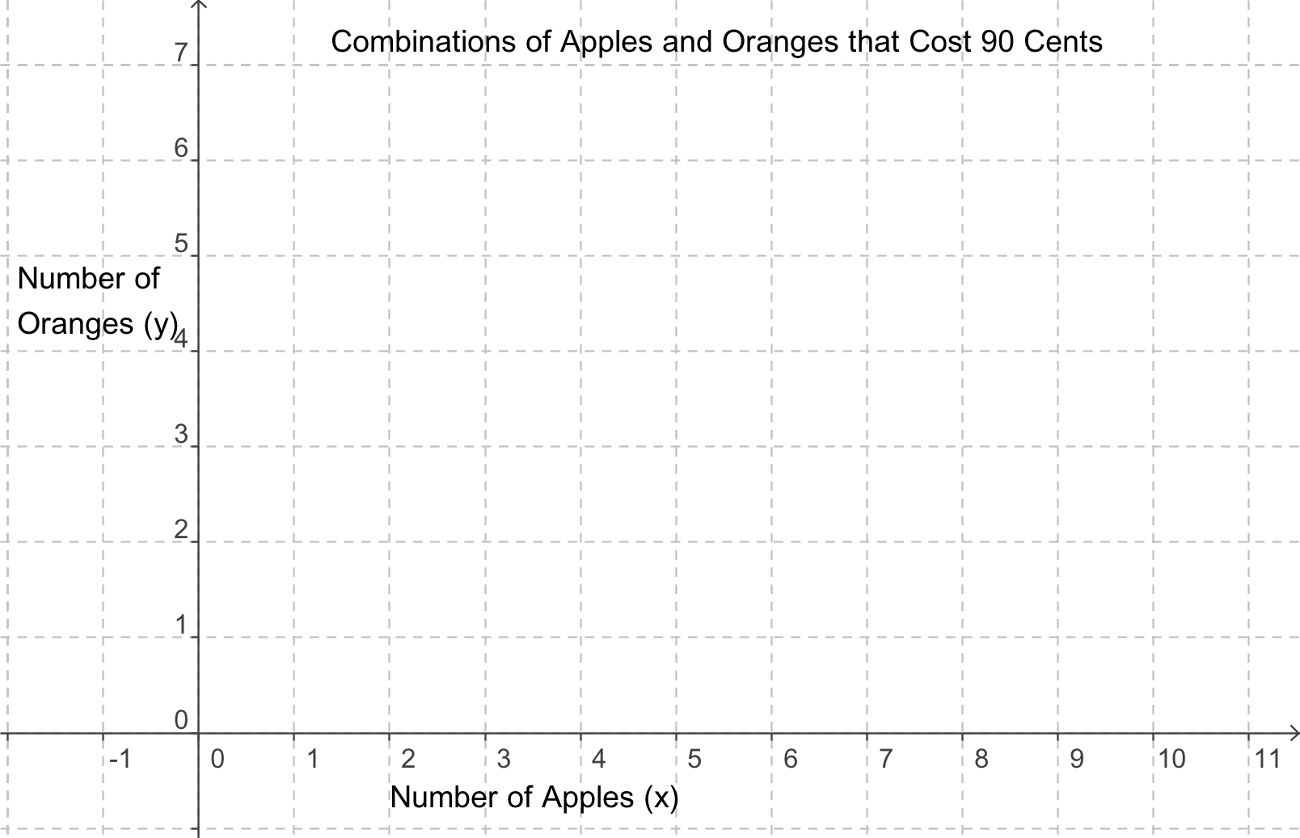
List the combinations that cost 90 cents.
Plot the combinations that cost 90 cents.
x = number of apples | y = number of oranges

Slide 33
Write an equation for the numbers of apples and oranges that cost 90 cents.
Word sentence | Number sentence (equation)
2 apples and 4 oranges cost 90 cents | 2 ∙ 9 + 4 ∙ 18 = 90
6 apples and 2 oranges cost 90 cents
10 apples and 0 oranges cost 90 cents
___ apples and ____ oranges cost ____
___ apples and ___ oranges cost ___
___ apples and ___ oranges cost ___

Slide 34
Write an equation
How can you use this information to write an equation in standard form? Ax + By = C
What is constant (the same) in each equation?
What varies (or changes) in each equation?
Identify the axis for each fruit.
Write an equation in standard form for the total cost of x apples and y oranges.

Slide 35
A mixture problem
You want to make 3 pounds of trail mix from nuts and raisins.
You have $10 to spend.
Nuts cost $4 per pound.
Raisins cost $2.50 per pound.
How much of each should you buy?

Slide 36
Grid tables and 3D graphs
What does a grid table look like when graphed?
Headings in the table are the x and y values.
Entries in the table are z values (vertical) for each pair (x,y)

Slide 37
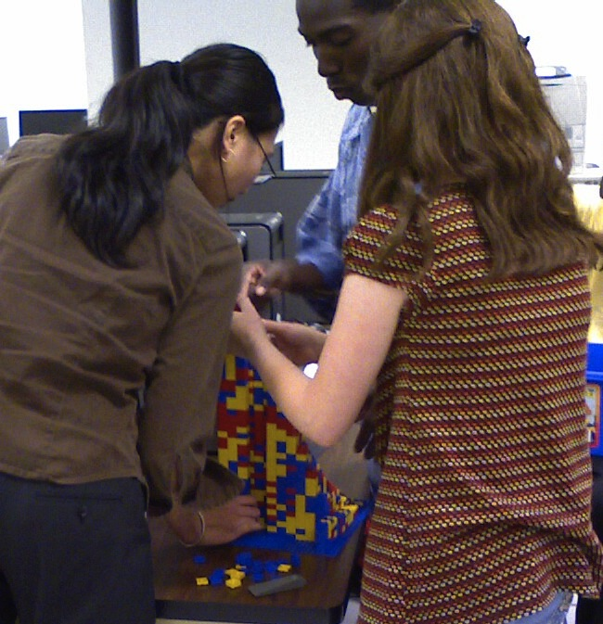
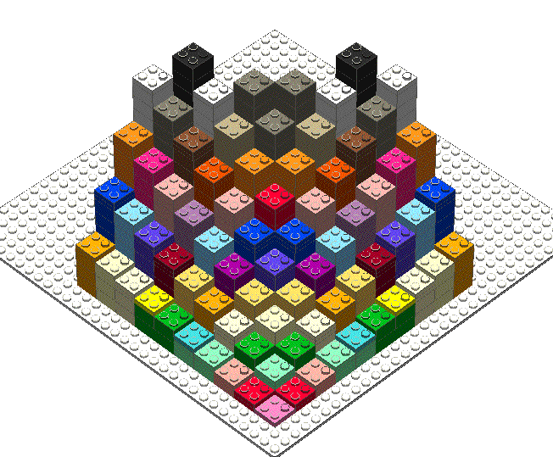
Multiplication table graph with Legos
You can build the multiplication table with Legos.

Slide 38
Iteration
Repeating the same process/function over and over, often using previous output as next input.
Hidden in our current curriculum:
  Multiplying by a positive whole number can be computed by repeatedly adding that number
  Raising a base to a positive whole number exponent can be computed by repeatedly multiplying by that number
  Square root algorithms
  Compound interest

Slide 39
A very interesting textbook
Iterative Algebra and Dynamic Modeling : A Curriculum for the Third Milennium
Kurt Kreith and G. Donald Chakerian
Algebra II prerequisite
Uses spreadsheets and systems modeling software to solve mathematical and other problems

Slide 40
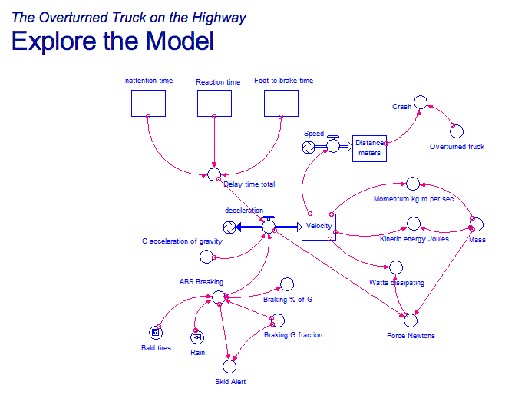
Modeling with Stella software (screen shot)
Measuring the World 4

Slide 41
An ancient square root algorithm
Babylonian, about 2000 BC
To approximate the square root of, say, 14:
  Make a guess. Doesn’t have to be a great guess.
  Is it correct? Check by dividing 14 by the guess. If it’s right, quotient will equal the divisor.
  If not, average the divisor and the quotient.
  Repeat the process with this as the new guess.
Implement this in a spreadsheet.
How many steps did it take to get 10 decimal places?

Slide 42
Interest (CA Framework now includes financial literacy)
Imagine you borrowed $100.
Lender charges “rent” (interest) for using the money.
The amount of interest depends on
  how much you borrowed and
  how long you kept the money.
Interest rate is a double ratio: 12% annual interest rate means per cent per year:
  for every dollar you borrowed and for every year you kept it, you pay 12/100 of a dollar.

Slide 43
Compound interest
Suppose you borrowed $100 at 12% annual interest. At the end of the year you owe $112.
If you don’t pay the money back, now you will owe interest on $112 at the end of the year.
At the end of the next year you will owe $112 plus the interest on $112
…and so on.

Slide 44
Make a table in a spreadsheet
Type as little as possible; have the spreadsheet do the work
Use as many columns as you like, to keep your ideas clear. Unlike algebra, you don’t want a single expression or equation.
Month | Balance ($) | Interest
0 | 100 | [have spreadsheet compute the interest]

Slide 45
Make a table in a spreadsheet
To tell the spreadsheet to calculate something, start with an = sign.
Instead of typing the number, type the address of the number.
 | A | B | C
1 | Month | Balance ($) | Interest
2 | 0 | 100 | =B2*0.12
 | A | B | C
1 | Month | Balance ($) | Interest
2 | 0 | 100 | 112

Slide 46
Make a table in a spreadsheet
Type formulas for A3 and B3
 | A | B | C
1 | Month | Balance ($) | Interest
2 | 0 | 100 | 12
3 | =A2+1 | =B2+C2
Copy the formula in C2 and paste into C3.
 | A | B | C
1 | Month | Balance ($) | Interest
2 | 0 | 100 | 12
3 | 1 | 112 | =B3*0.12

Slide 47
Make a table in a spreadsheet
When you copy a formula down one row, the address changes down 1 row. Similar for columns.
 | A | B | C
1 | Month | Balance ($) | Interest
2 | 0 | 100 | =B2*0.12
3 | 1 | 112 | =B3*0.12

Slide 48
Make a table in a spreadsheet
Fill all the formulas down:
  Highlight cells A3, B3, C3
  Hover over the lower right corner
  Drag down as far as you want
  All rows will be copied with addresses adjusted
 | A | B | C
1 | Month | Balance ($) | Interest
2 | 0 | 100 | =B2*0.12
3 | =A2+1 | =B2+C2 | =B3*0.12
4 | =A2+1 | =B3+C3 | =B3*0.12
5 | =A2+1 | =B4+C4 | =B3*0.12

Slide 49
Interpreting the results
If you don’t pay the money back for 10 years, how much will you owe?
How many years will it take to owe $200? 300?
Think of some other questions you could answer with this spreadsheet.

Slide 50
Adjust the model
Actually, interest is often computed monthly, or even daily.
The monthly interest rate is the annual rate divided by 12.
Redo your spreadsheet (or make a copy and edit) to show monthly interest calculations.

Slide 51
Make graphs
See handout or demonstration for how to make a graph (“chart”) showing the growth over time.
Choose scatter plot.

Slide 52
Other situations to model
Folding paper. A stack of 500 sheets of paper is 2 inches thick. If you repeatedly fold 1 sheet in half, how many layers will there be at each step? How thick will it be?
Vampires: A lesson done by the Functioning Coefficients group in Project DELTA (7th grade.) Vampires must feed on human blood every day. When a vampire bites a human, the human becomes a vampire. If a vampire enters a town of 10,000 people, how long will it take for everyone to become a vampire? What about the whole state? The whole world? What does this say about whether vampires could exist?

Slide 53
Videos of exponential growth on the web
Search YouTube for
  Exponential growth
  Folding toilet paper
  Making croissants
  Chain reaction
A short YouTube playlist:
http://www.youtube.com/playlist?list=PL9EC9D65812CB646C

Slide 54
Thanks!
Let me know if you use any of these activities in your classroom.
Susan Addington: saddingt@csusb.edu

